Slide 1
My Journey: From Childhood to Now
Bijaya Chhetri
(A Story of My Life)

Slide 2
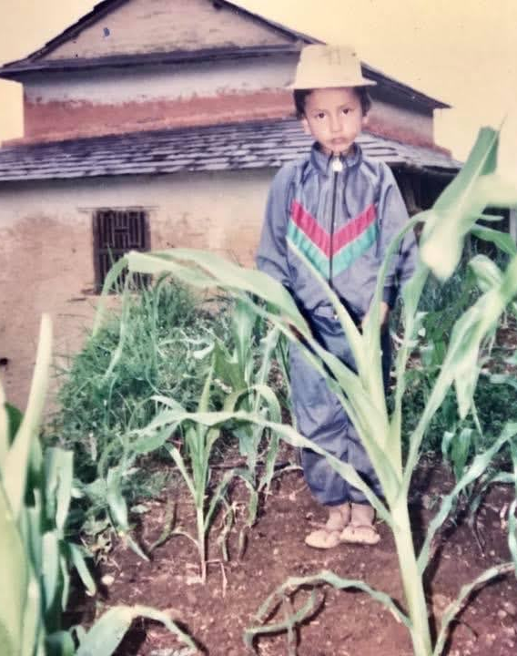
Introduction
Your Photo Here
Greeting
Why I am sharing my story
Fun fact about me

Slide 3
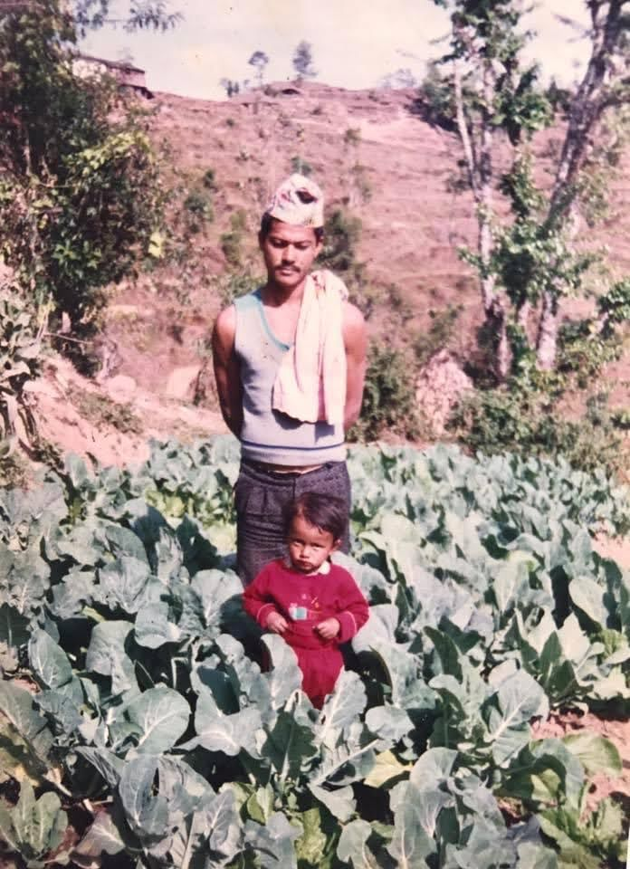
Childhood with mom
Your Photo Here
Baby and childhood photos
Place of birth, family background
Favorite childhood memories

Slide 4
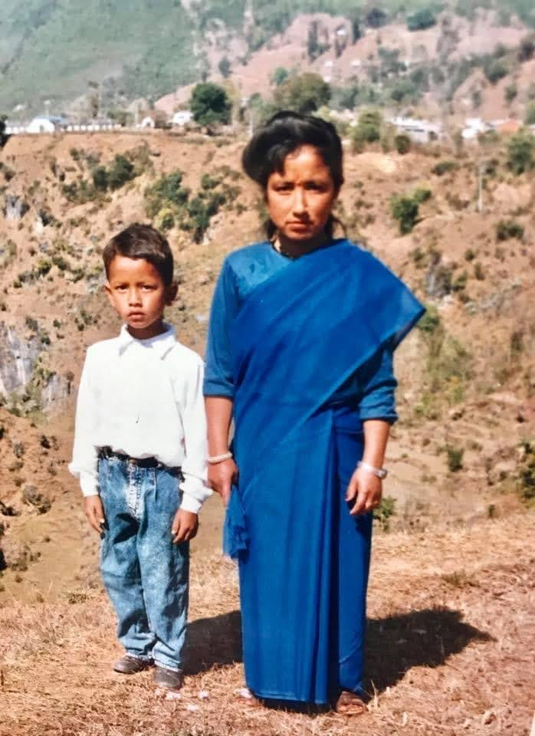
Childhood with Dad
Your Photo Here
Baby and childhood photos
Place of birth, family background
Favorite childhood memories

Slide 5
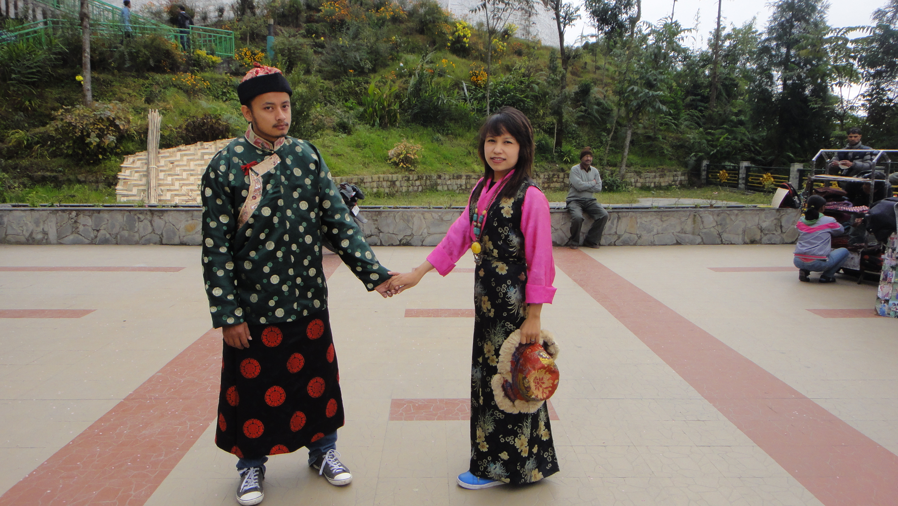
School Days Darjeeling Tour
First school memories
Favorite subjects
Hobbies and activities
Your Photo Here

Slide 6
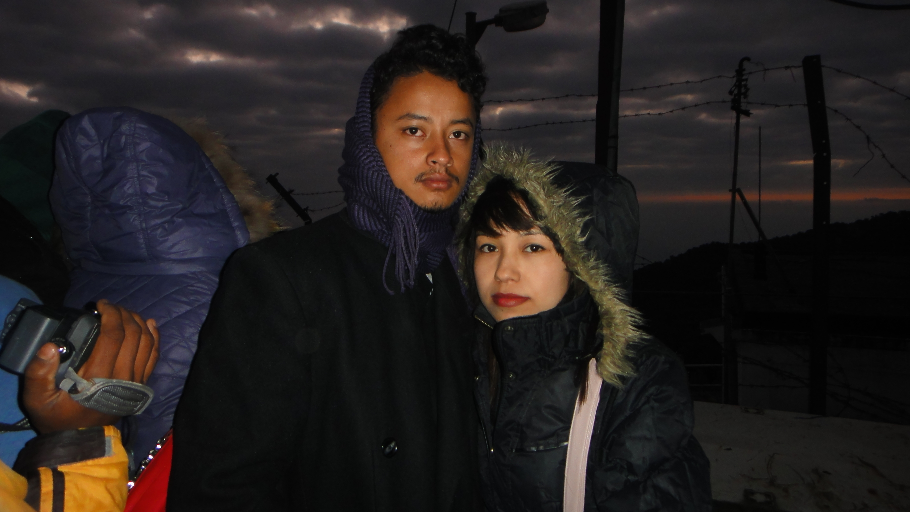
Teenage Years
experiences
Your Photo Here

Slide 7
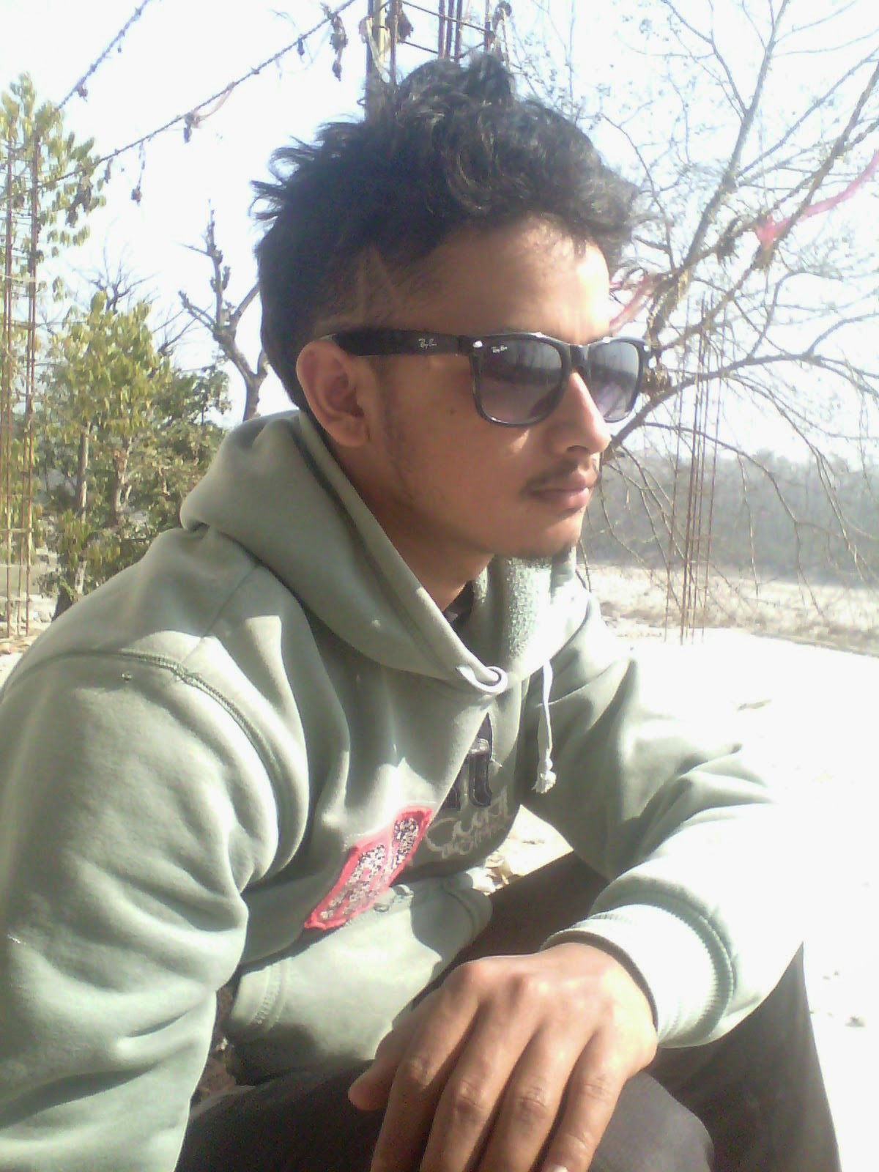
Young Adult Life
Message, Description
Your Photo Here

Slide 8
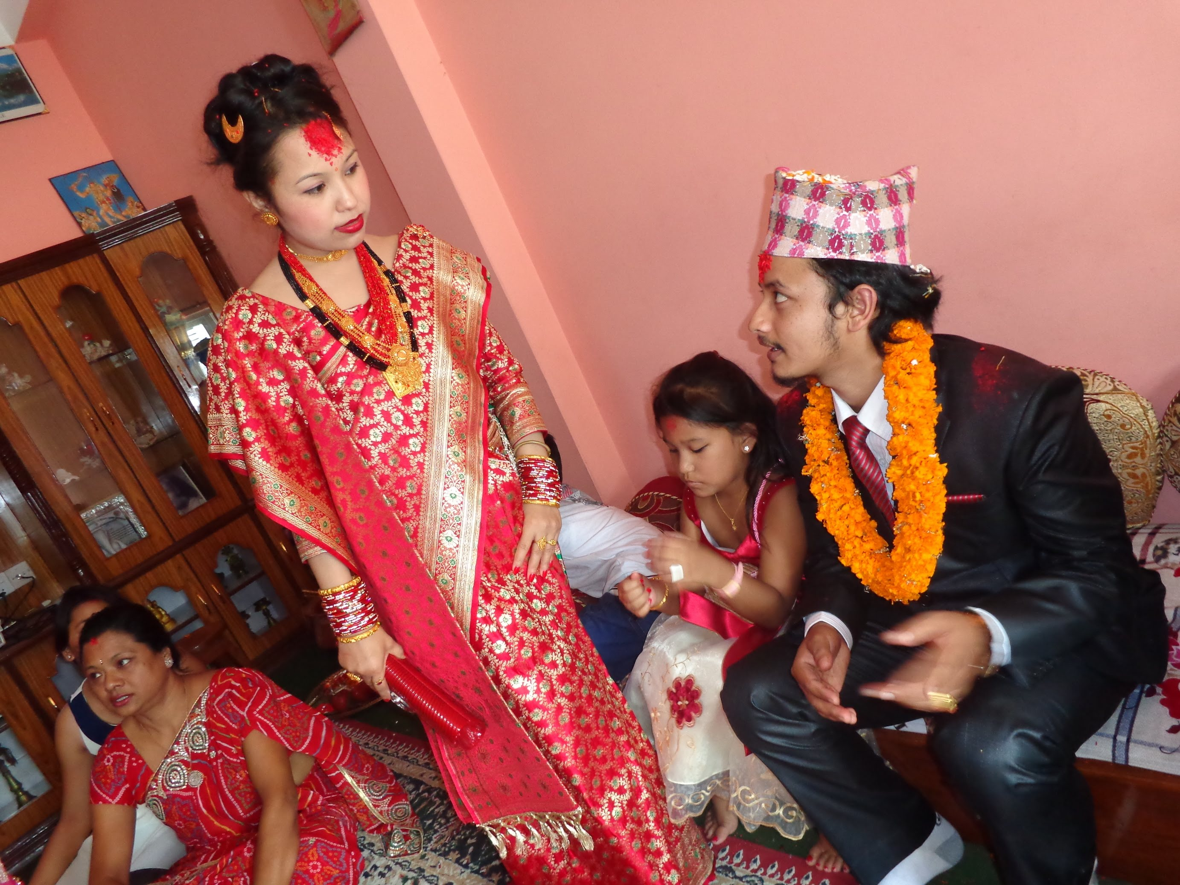
Wedding
moments
Description
message
Your Photo Here

Slide 9

National attire of Nepal
Your Photo Here
Current studies, job, or projects
Hobbies and passions today
Personal goals

Slide 10
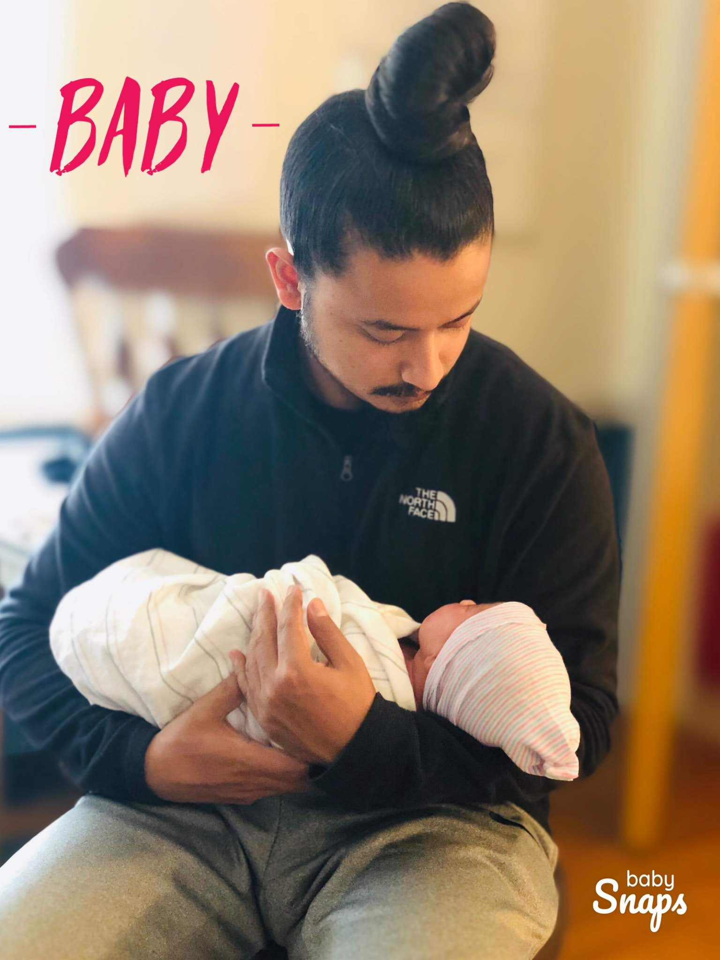
Welcome Baby
Your Photo Here
message

Slide 11
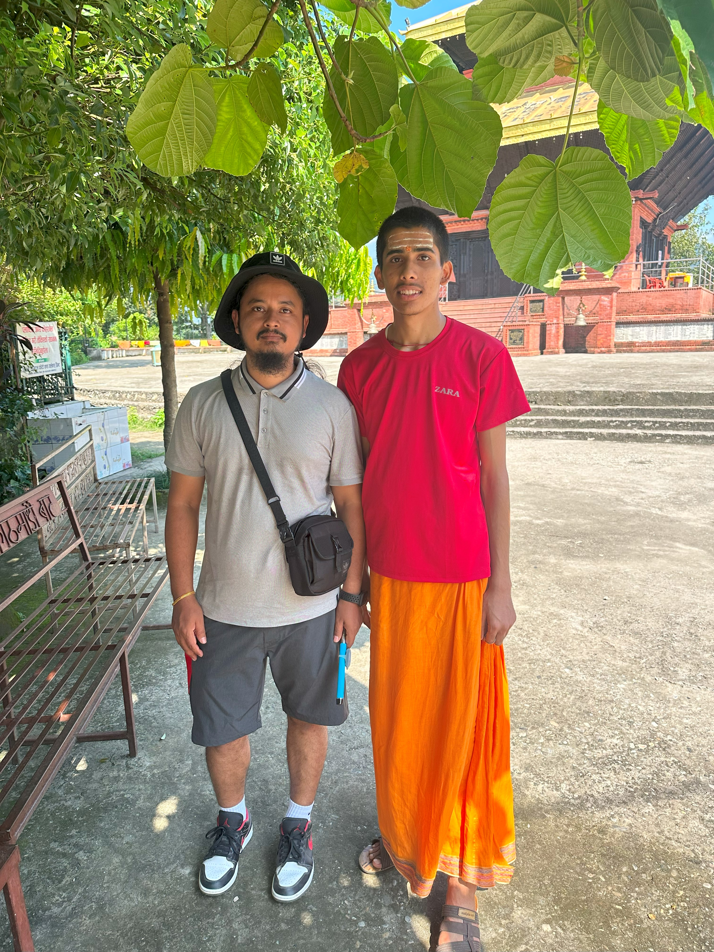
Devgat: Nurturing the Priests of Tomorrow
Your Photo Here
Message

Slide 12
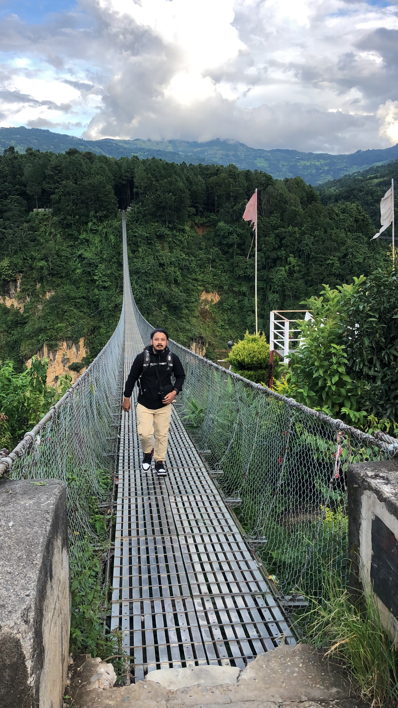
Adventure
Your Photo Here
Message , place, Description

Slide 13
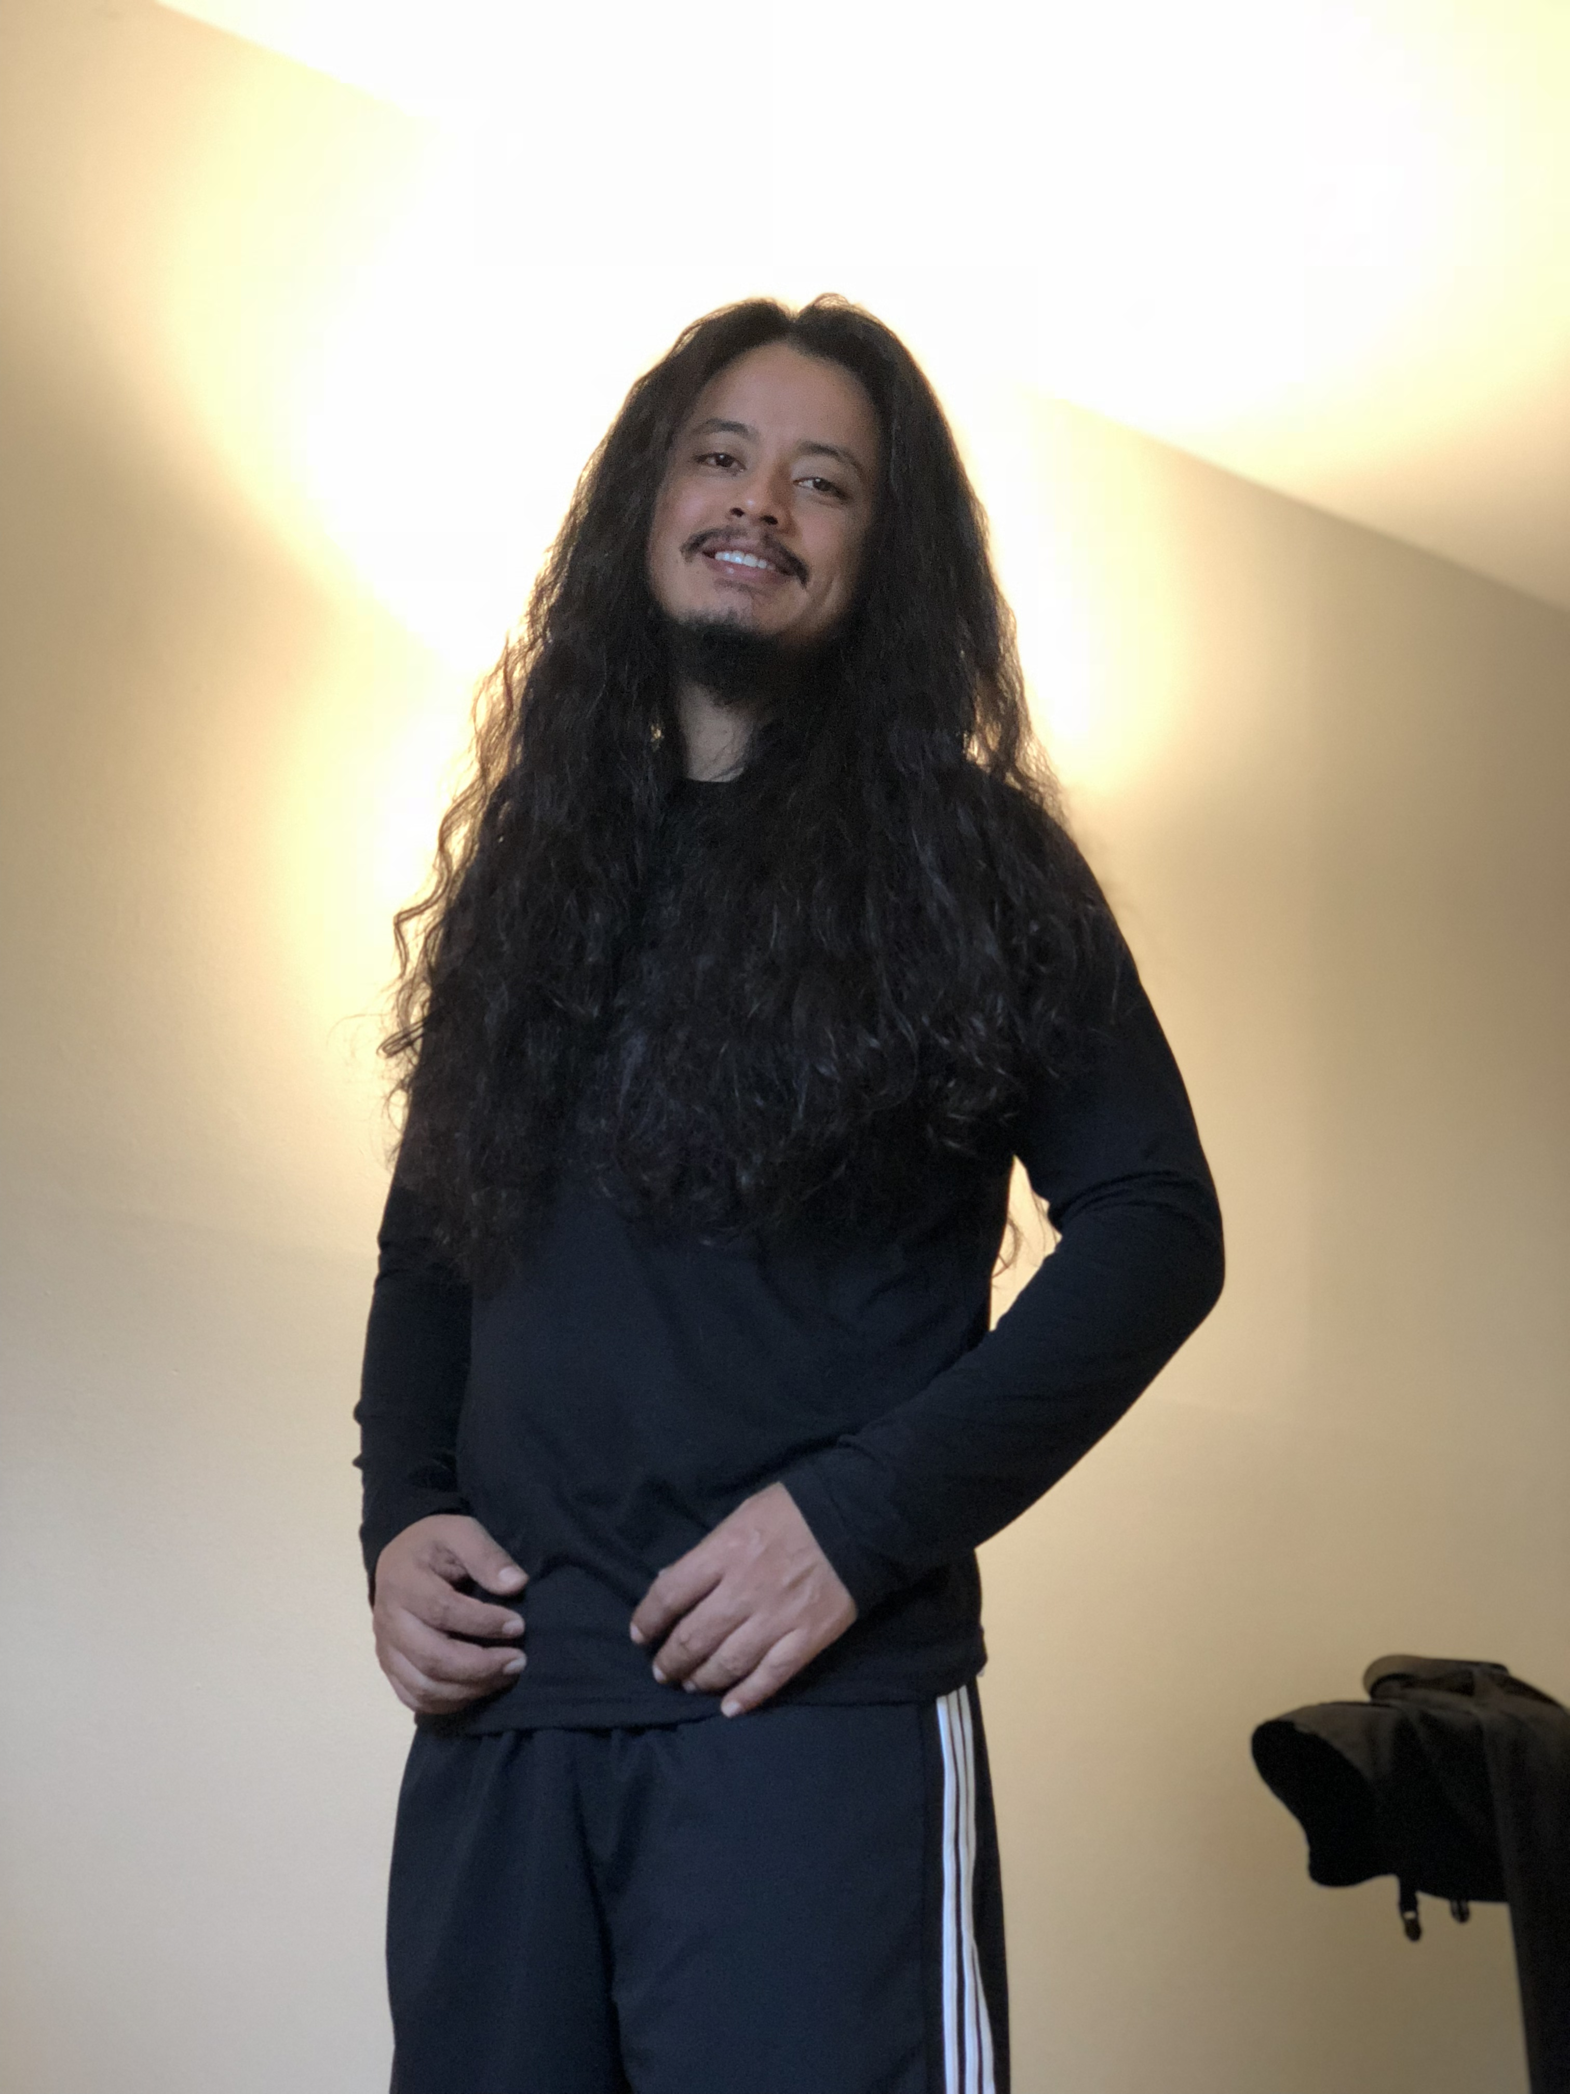
Thank you
Your Photo Here
Message , place, Description

